Slide 1
Understanding Discrepancy Between Design and Implementation of Inventory Policies
Mxd-21-10-06
Nenad Nenadic
PI, Rochester Institute of Technology

Slide 2
PROJECT OVERVIEW
PROBLEM STATEMENT
GOALS & OBJECTIVES
KEY BENEFITS
TRANSITION PLAN
What is the business case being addressed?
Practitioners do not adhere closely to the designed inventory policies
The reason for discrepancies is not obvious
What technical problem is being addressed?
Determine
Hat is the solution?
What is the key deliverable?
What is unique about this project research compared to existing solutions?
What happens to the project outcomes after the project is done?

Slide 3

3
PROBLEM STATEMENT
PROBLEM DESCRIPTION
What is the purpose of this project?
MxD Proprietary: Do Not Distribute

Slide 4
USE CASE SCENARIOS
MxD MEMBERSHIP USE CASE
As a [specific user defined by job title/description], I want [to perform some task] so that I can [achieve some goal/benefit/value]
COMMERCIALIZED SOLUTION USE CASE
As a [specific user defined by job title/description], I want [to perform some task] so that I can [achieve some goal/benefit/value]

Slide 5
GOALS & OBJECTIVES
List project goals and objectives including description of the solution

Slide 6
PROJECT SUCCESS CRITERIA & KPI
Describe KPI and Success Metrics (both baseline/benchmark and future state) and measurement methods.

Slide 8
USE IF COMMERCIALIZATION PLAN IS WELL DEFINED, OTHERWISE DELETE

Slide 9
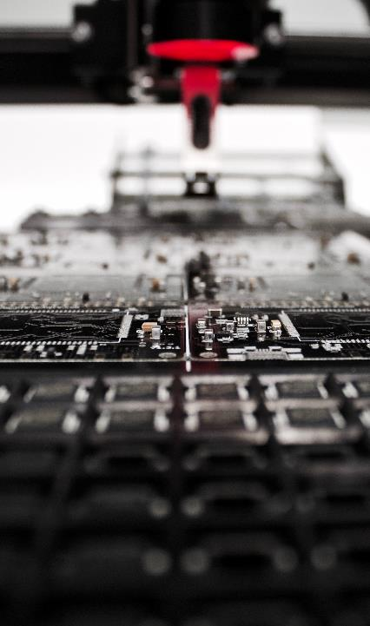
REVIEW OF PROGRESS
9
What did the team plan to do this past quarter?
What did the team accomplish this past quarter?
How do these technical progress details tie into the overall solution?
What is the connection of each task to the end goal?
Opportunity for demonstration of project work
MILESTONES PLANNED PAST QUARTER | PLANNED END DATE | ACTUAL END DATE | STATUS
MxD Proprietary: Do Not Distribute

Slide 10
REVIEW OF PROGRESS

Slide 11
DEMONSTRATION

Slide 12
DEMONSTRATION
Opportunity to demonstrate project work

Slide 13
DEMONSTRATION

Slide 14
TECHNICAL LESSONS LEARNED
What went well?
What went poorly? And associated learnings?
What do you want to do differently?
When answering these questions, keep in mind:
  the teams understanding of the problem space
  the technical feasibility of the solution
  the solution value to industry users
  impediments to project solution success within industry

Slide 15
HOW TO GET INVOLVED
Explain how MxD Members can get involved or provide support
  What technical feedback do you need?
  Do you need testing/validation sites?
How might the team better leverage the MxD network?
Do you need a transition or commercialization partner?

Slide 17
BACK-UP SLIDES
Following slides provided as back-up for information presented

